Slide 1
FOLDER STRUCTURE
PROJECT NAME
SRC
Front end files:
App.css
app.jsx
Index.css
Main.jsx
DB
Database files:
dbTableName(s)
users.cjs
otherTableNames.cjs
Seed.cjs
These hold the functions for those tables
API
Router files:
users.cjs
otherTableNames.cjs
Main folder
Public Files:
.gitignore
Index.html
Package.json
Readme.md
Server.cjs
Vite.config.js
.eslintrc.cjs
ASSETS
An area for storing other assets
Images
Sound
video
BUILD
These files are for the built website and can be uploaded to a hosting site
NODE MODULES
These are node modules needed to run the program. DO NOT UPLOAD TO GIT (too big) when building, necessary modules are incorporated into the build.

Slide 2
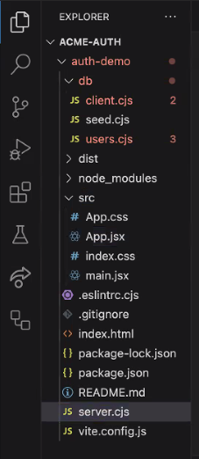
FOLDER STRUCTURE

Slide 3
WORKING STEPS
Set up
Create form for user and pw
Create database called PROJECTNAME?
Create server.cjs file
Create client.js
Create seedAndSync file
Create route to access users
Create the function get user
Create the function create user
VS, Vite, git, React
Js, html, css
psql
Create table called users
Express route?
For testing, display table in webpage?
Create login
Create token
Store token on local computer
Check token to stay logged in
Encrypt pw to and from db
Encrypt database pw
Build Project
Json webtoken
B-crypt
dotenv
Axios

Slide 4
to install vite
npm create vite@latest
name
JS
Code . (to go into vite folder)
Npm install (installs NPM – node package manager)
Npm run dev (funs the program and monitors for changes)
Clean up files, remove unwanted, clear css, update readme
GIT PROCESS HERE
Set up
GIT PROCESS
In github: create repository
Git init (initializes the git )
Follow directions from GITHUB
VS, Vite, git, React
import React, { useEffect, useState } from "react"

Slide 5
GIT
To revert to previous git status:
git fetch --all
git reset --hard origin/main

Slide 6
to install react router
npm install react-router-dom
In main.jsx file:
<hashrouter>
<app/> (surround the app function with hasrouter)
</hashrouter>
import { HashRouter, Route, Routes, Link } from "react-router-dom";
In app.jsx file:
Return(
<routes>
<Route path = ‘/’ element = {<h1> hello </h1> }/>
<Route path = ‘/’ element = {component/>}/>
</routes>
)
import { HashRouter, Route, Routes, Link } from "react-router-dom";

Slide 7
Screen layout
Create form for user and pw
Username:
Password:
Js, html, css
submit
Success or fail message

Slide 8
In terminal:
Npm init –y (Creates package.json the –y takes default answers)
Npm install express (this creates node_modules, local host defaults to 8000)
Npm install pg (installs postgresql)
If a git does not exist, and you plan to use one later….
touch .gitignore
node_modules (this prevents node_modules from being uploaded to the repository --- it is too large)
Npm install nodemon (this allows the server to be monitored similar to npm run dev)
inside package.json you can create scripts to speed up common commands, example: in the scripts section
“start:dev”: nodemon server.cjs
Create database called PROJECTNAME?

Slide 9
It is helpful to open a second terminal at this point
To create the database:
psql (opens psql for sql commands)
CREATE DATABASE database_Name; (don’t forget the “;” it ends the command and won’t work without it. Also avoid using hyphens, use underscores instead)
\l (list the databases to ensure it was created)
psql
BASIC PSQL COMMANDS:
\l list of databases
\c nameOfDb connects to the nameOfDb database
\d shows the tables in the database
\q or Ctrl-C quits psql

Slide 10
Create client.js
Touch db/client.js
Inside client.js
const(Client} = require(‘pg’);
const client = new Client(‘postgres ://host:####/dbname’);
Module.exports = client;
This is where the program is connecting to the database
Note the capitalization of “Client” in 2 key places

Slide 11
Create server.cjs file
Create server.js (sometimes called index.js)
Inside server.js:
Const express = require(express);
Const app = express();
Const PORT = ####;
App.listen(PORT, ()=>{console.log(`server is running on port ${PORT}`);});
Route:
app.get(‘/hello’, (req, res) => {res.send(‘hello world’);});

Slide 12
Create seedAndSync file
const dropTable = async()=>{
try{
await client.query(`
DROP TABLE IF EXISTS users
`)
}catch(err){
console.log(err)
}
};
Create seedAndSync.js
Inside seedAndSync.js:
Const {client} = require (‘./client.js);
Const seedAndSync = async ()=>{
try{
await client.connect();
///insert code here to create tables///
dropTable(); (like this)
createTable(); (like this)
client.end(); (this closes the connection to the db)
}catch(err){
console.log(err);
};
Create table called users
Function definitions go here
const createTable = async()=>{
try{
await client.query(`
CREATE TABLE users
id SERIAL PRIMARY KEY,
name VARCHAR(30)
`)
}catch(err){
console.log(err)
}
};
ANY TIME YOU TALK TO THE DATABASE, USE AWAIT!

Slide 13
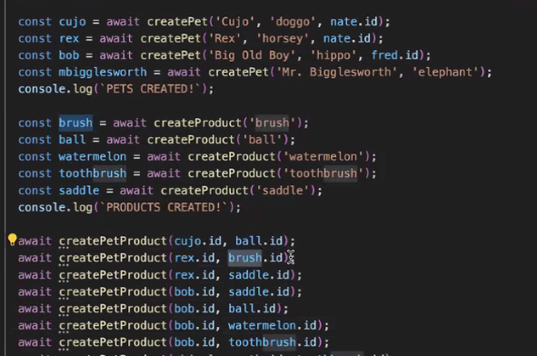
Example of seed data:

Slide 14
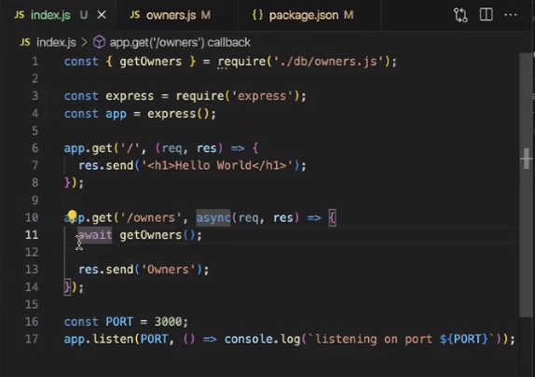
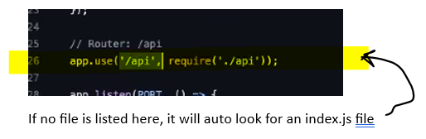
Create route to access users
This was run earlier, but including here as well. Express needs to be installed.
Npm install express (this creates node_modules, local host defaults to 8000)
Example:
Express route
In the API Folder:
Inside index.js or index.cjs
const express = require(‘express’);
const router = express.Router();
module.exports {router};
Using the file name “index” will catch any requests going to the api

Slide 15
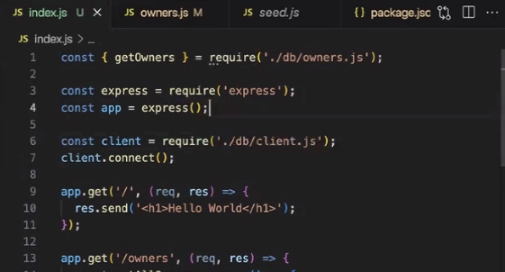
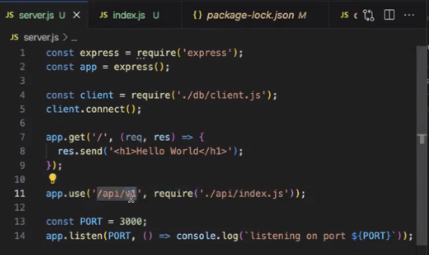
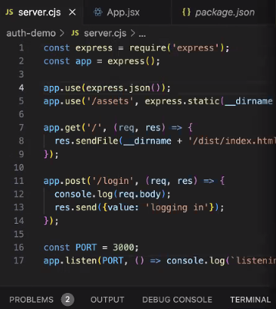
Create route to access users
Linking Front to Back
In the API Folder:
Inside index.js or index.cjs
Express route
In the main Folder:
Inside server.Cjs
This line is important, it reads json body

Slide 16
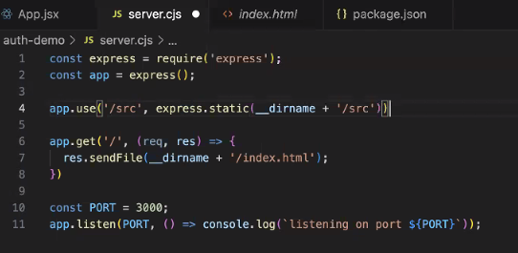
Create route to access users
Linking Front to Back
Npm build
Express route
This line is needed for when building so it can redirect to correct file
Once you do this, you need to re-build after changes for them to take effect.
Once built with this line, it can be deployed to a website and find the correct files

Slide 17
Create the function get user
EXAMPLE:
Create db/dbusers.cjs
Inside:
require {getUser} = require(‘/users.js’);
const getUser = async(name) =>{
try{
await client.query (`
fetch users (name),
VALUES (‘${name}’)
WHERE user.name = ${name}
`)
}catch(err){
console.log(err);
}
module.exports {getUser}

Slide 18
Create the function create user
FOR EACH TABLE, CREATE A FILE TO HANDLE CRUD
dbname.cjs (name of the table) also, use .cjs to avoid js runtime errors
EXAMPLE:
Create db/dbusers.cjs
Inside:
require {createUser} = require(‘/users.js’);
const createUser = async(name, password) =>{
try{
await client.query (`
INSERT INTO users (name, password),
VALUES (‘${name}’ ‘${password}’)
`)
}catch(err){
console.log(err);
}
module.exports {createUser}
To handle null values add this:
If(!name){name=null}
Use single quotes here

Slide 19
For testing, display table in webpage?

Slide 20
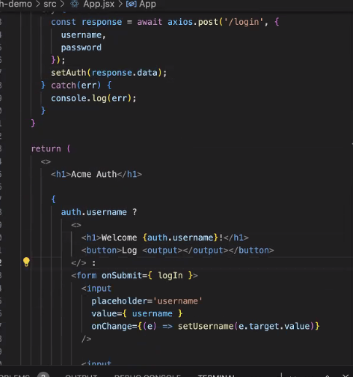
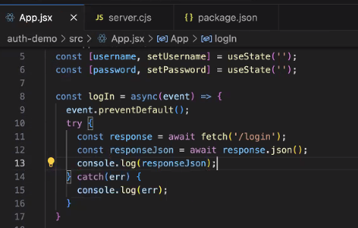
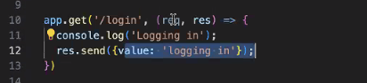
Create login
examples
In app.jsx this checks the data entered with the db
In server.cjs add this code to route to the login

Slide 21
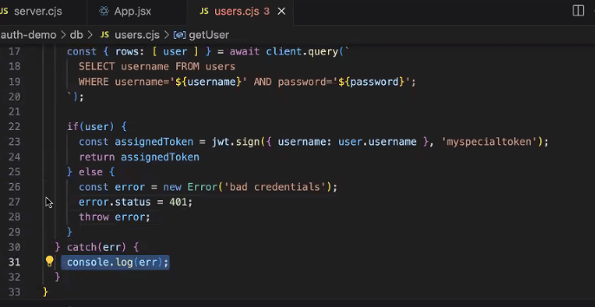
Create token
npm install json web token
Jwt.io for more information
In any files using json web token, add this line:
Const jwt = require(‘jsonwebtoken’)
Json webtoken
Myspecialtoken is the encryption key

Slide 22
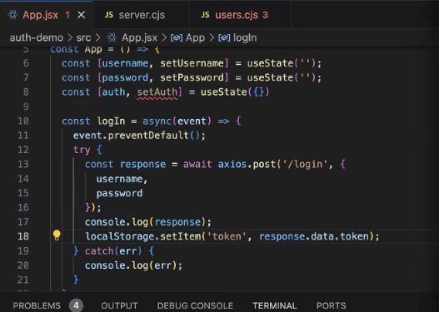
Store token on local computer
This stores on the users local browser

Slide 23
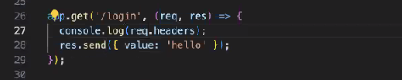
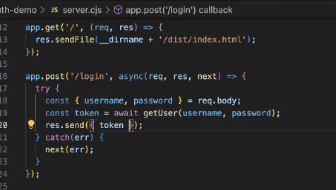
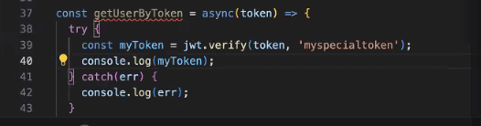
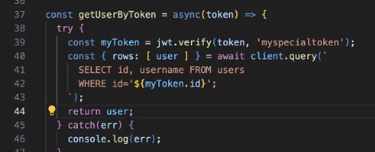
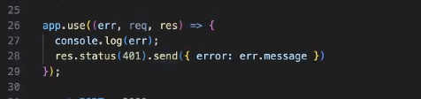
In server.cjs
Check token to stay logged in
In db/users.cjs
Then update to:

Slide 24
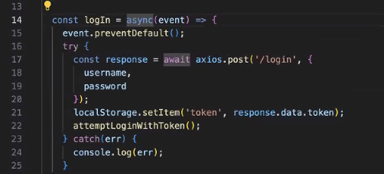
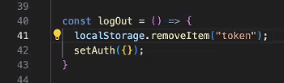
Check token to stay logged in
In app.jsx
When logout runs, it erases the local storage token

Slide 25
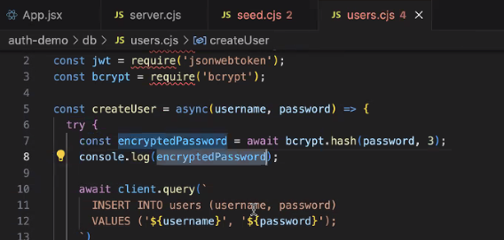
Encrypt pw to and from db
B-crypt
npm install bcrypt
3 lines of code: import, hash, compare
Line 1 goes in seed.cjs
B-crypt
IMPORT

Slide 26
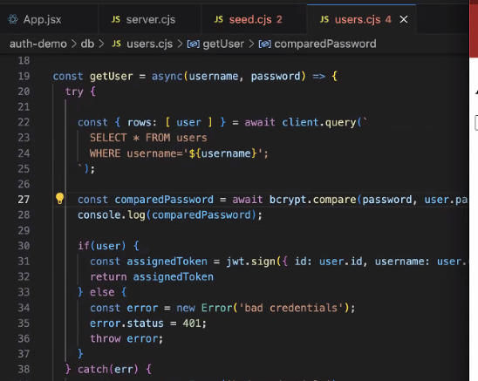
Encrypt pw to and from db
B-crypt
npm install bcrypt
3 lines of code: import, hash, compare
Line 2 goes in users.cjs
B-crypt
HASH

Slide 27
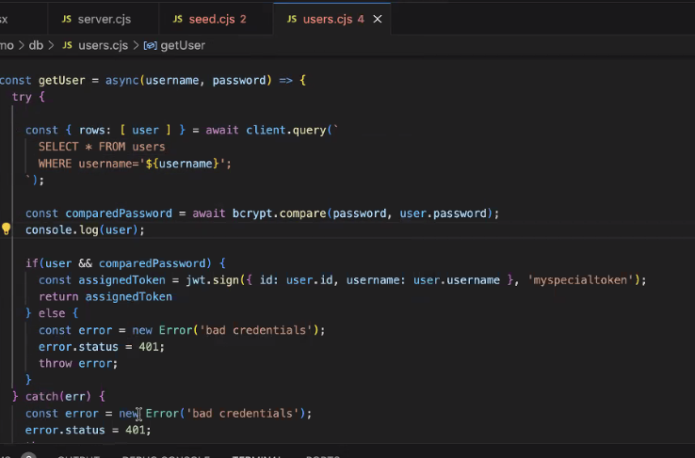
Encrypt pw to and from db
B-crypt
npm install bcrypt
3 lines of code: import, hash, compare
Line 3 goes in users.cjs
B-crypt
compare

Slide 28
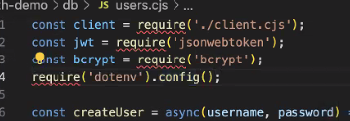
Encrypt database pw
dotenv
npm install dotenv
touch .env
dotenv
Can be in users.cjs but best in server.cjs

Slide 29
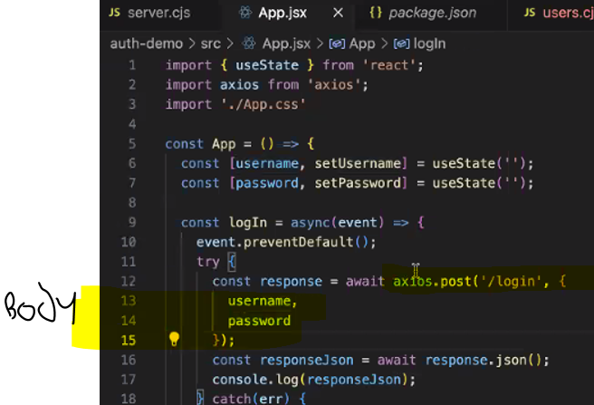
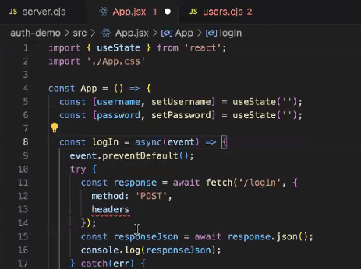
Axios
Axios
npm install axios
must be installed, use instead of fetch
AFTER AXIOS
BEFORE AXIOS

Slide 30
Axios

Slide 31
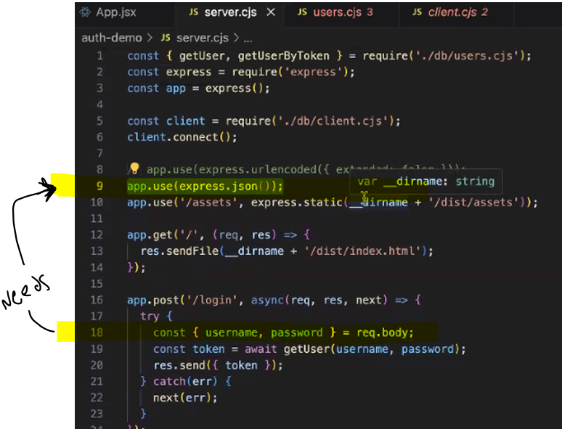

Slide 32
Build Project
Npm run build
Creates a build folder, this folder can be uploaded to netlify or other web-hosting location
The program has to be built because it cannot read react files.
App.use(express.static(‘./dist’))

Slide 34
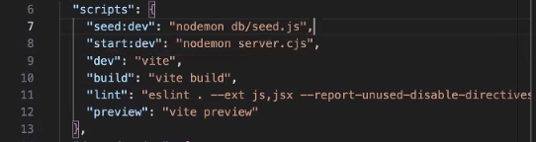
Script ideas:
Inside package.json

Slide 35
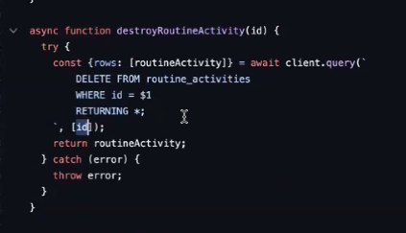
Additional notes
$1 points to the first item in the array similar to ${id} -- if id was the first element in the array.

